Slide 1



E-Waste Generation Classification

Slide 2

Learning Objectives
Understand Dataset Structure and Class Distribution
Load and Prepare Image Data Using TensorFlow
Apply Data Augmentation Techniques
Build a CNN Using Transfer Learning
Compile and Train the Model
Evaluate Model Performance
Deploy the Model
Model Saving and Reusability
GOAL
Source :
www.freepik.com/

Slide 3
Tools and Technology used
Programming Language:
Python
Deep Learning Framework:
TensorFlow / Keras
Pretrained Model:
EfficientNetV2B0 (ImageNet weights)
Data Handling & Visualization:
NumPy, Matplotlib, Seaborn, PIL
Model Evaluation:
Scikit-learn (confusion matrix, classification report)
Web Deployment:
Gradio
Environment:
Google Colab / Jupyter Notebook
OS / File Handling:
os, zipfile

Slide 4
Methodology
Data Extraction
The dataset is extracted from a zip file and organized into training, validation, and test directories.
2. Data Exploration The dataset structure is explored by visualizing class distributions and displaying sample images from each category.
3. Data Loading Image datasets are loaded using TensorFlow’s image_dataset_from_directory, which automatically assigns labels and resizes images.
4. Data Augmentation Basic image augmentations like horizontal flipping, rotation, and zooming are applied to enhance model generalization.
5. Model Architecture An EfficientNetV2B0 model is used as the base feature extractor, followed by custom dense layers for classification.

Slide 5
Methodology
6. Model Compilation The model is compiled using the Adam optimizer, sparse categorical cross-entropy loss, and accuracy as the evaluation metric.
7. Model Training The model is trained on the training set with early stopping to prevent overfitting, and validated on the validation set.
8. Performance Visualization Training and validation accuracy and loss curves are plotted to monitor the model’s learning behavior.
9. Model Evaluation The model is evaluated on the test set using accuracy, a confusion matrix, and visual inspection of predictions.
10. Model Saving The trained model is saved in .keras format for future inference or deployment.

Slide 6
Problem Statement:
E-waste (electronic waste) is rapidly becoming a serious environmental and health issue around the world. Proper sorting and categorization of e-waste is essential for efficient recycling and disposal, but manual classification is error-prone and labor-intensive.
This project aims to build an automated e-waste classification system using artificial intelligence and machine learning. By training a deep learning model on images of different types of e-waste, we can identify and categorize them accurately.

Slide 7
Solution:
Use image classification with EfficientNetV2B0 to classify e-waste into 10 distinct categories to support better sorting and recycling automation.
Transfer Learning with EfficientNetV2B0 The model uses EfficientNetV2B0, a state-of-the-art pre-trained convolutional neural network trained on ImageNet. Transfer learning allows the model to leverage learned visual features, reducing training time and improving performance on the e-waste dataset.
Image Classification with Fine-Tuned Layers A custom classification head is added on top of EfficientNetV2B0 to adapt it to the specific e-waste categories. The final layers are trained on the dataset while keeping base features intact for optimal accuracy.
Data Augmentation for Generalization Techniques like flipping, rotation, and zoom are applied to training images to introduce variability. This helps the model generalize better to unseen data and reduces overfitting.

Slide 8
Features:
Combined Data Exploration Function Class distribution plotting and sample image visualization are handled together in a unified explore_dataset() function for clarity and reuse.
Augmented Image Visualization Augmented images are visually displayed to ensure the transformations are meaningful and effective.
Dynamic Output Layer Definition The model's output layer dynamically adapts to the number of classes using len(class_names).
Gradio Interface The trained model is deployed using a Gradio web interface that allows real-time image uploads and predictions. This makes the solution accessible and easy to test without needing local setup.
Modular and Clean Training Workflow Model setup, augmentation, callbacks, and training are structured in a clear and minimal form for better readability and maintenance.
Labeled Subplots for Training Metrics Accuracy and loss are plotted with well-organized, labeled subplots for easy interpretation of training performance.

Slide 9
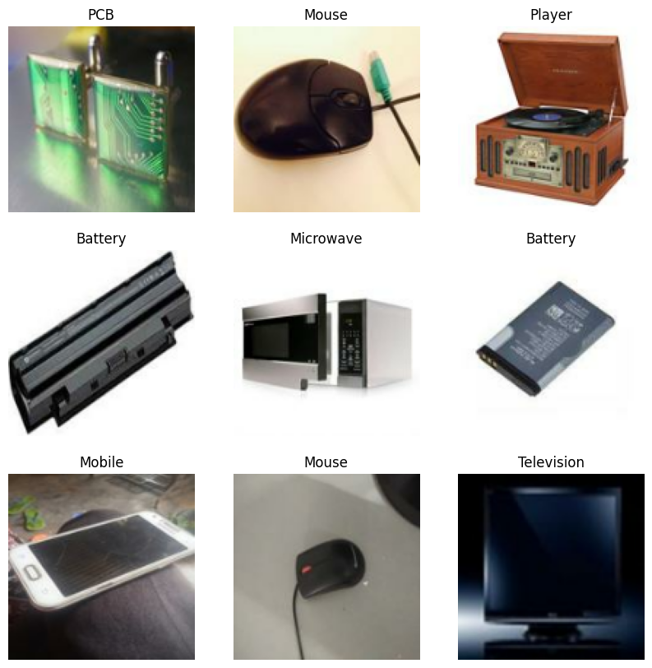
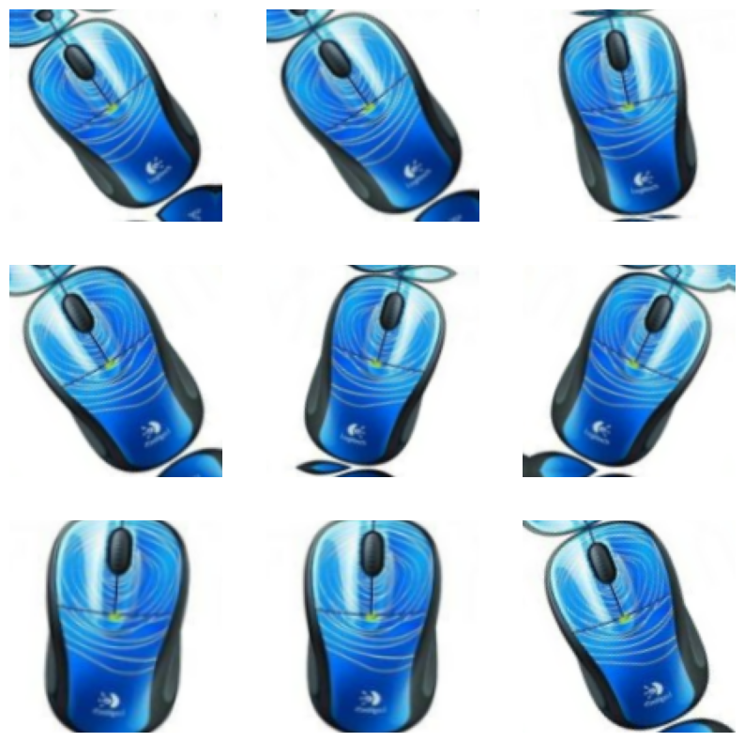
Screenshots of Output:

Slide 10
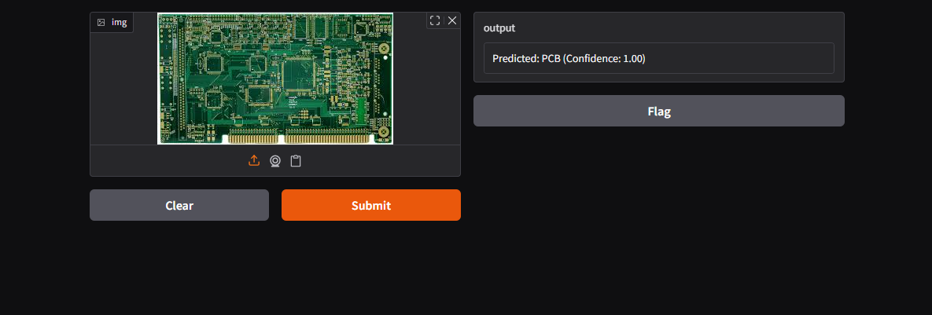
Screenshot of Output:

Slide 11
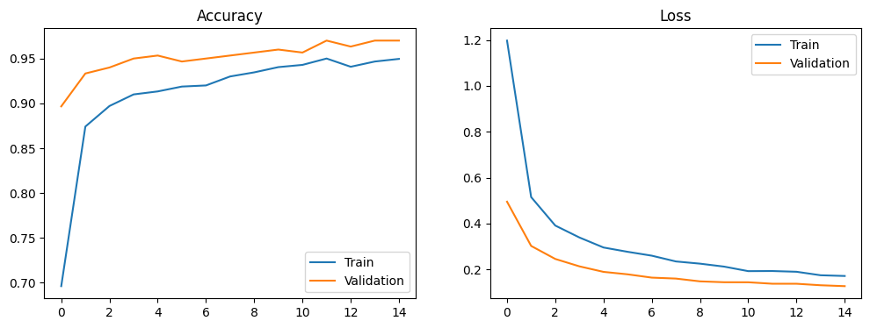
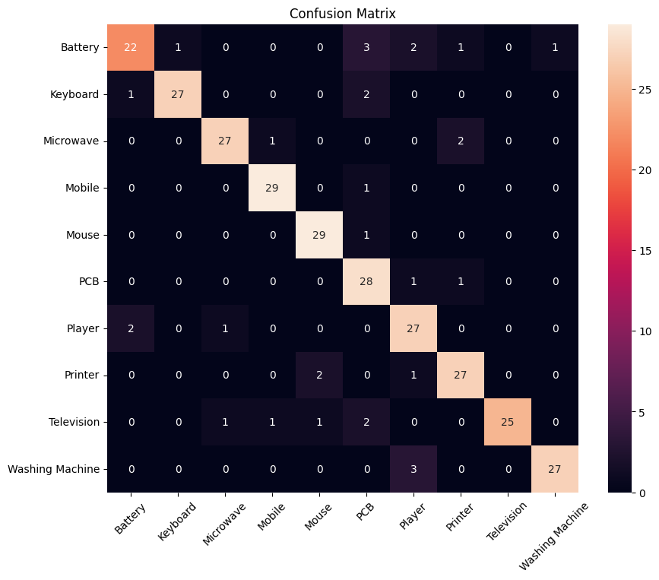
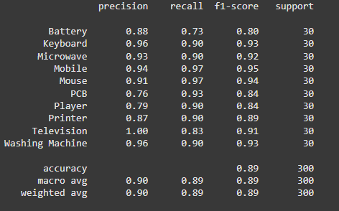
Screenshots of Analysis:

Slide 12
Conclusion:
The e-waste classification model successfully demonstrates the power of transfer learning by achieving accurate predictions using EfficientNetV2B0. Through data augmentation, structured training, and a user-friendly Gradio interface, the solution offers a practical and deployable tool for electronic waste identification.

